Slide 1
Adaptive Real-Time Strategic Agent for StarCraft
Student Name
Abdelrahman Elogeel
Advisor Name
Matthew Alden
Andrey Kolobov
Ankur Teredesai

Slide 2
Problem Motivation [1]
Gaming industry
Static AI, boring, can’t teach bot
Robotics
Experimental relevance
City building, etc…
War simulation
Learn timing attacks, retreats, smart automated units

Slide 3
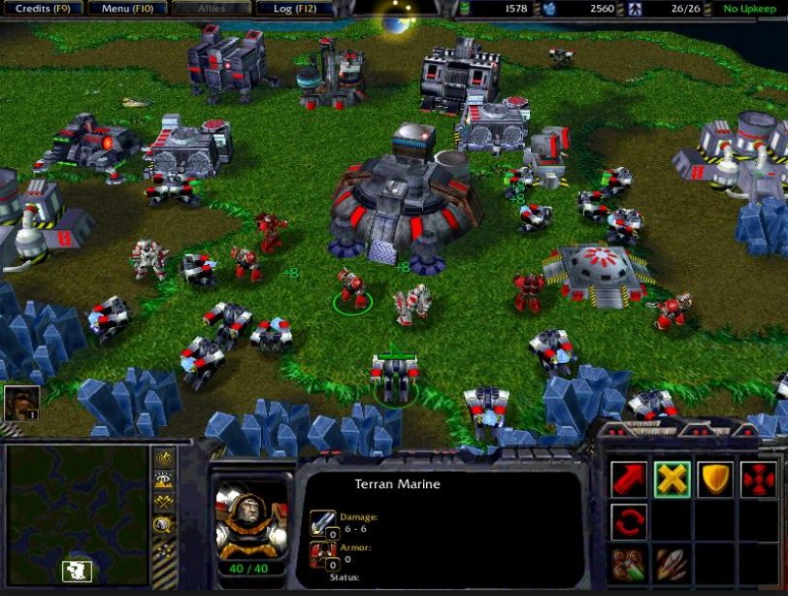
Domain
RTS Games
Real-Time Strategy Games.
StarCraft – Blizzard Entertainment
Severe Time Constraints – Real-Time AI – Many Objects – Imperfect Information – Micro-Actions

Slide 4
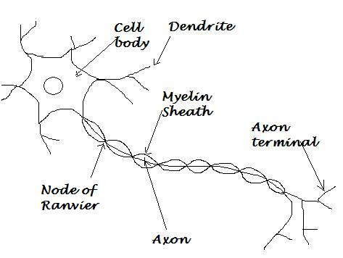


Problem Definition
Adaptive
Real-Time
Agent

Slide 5
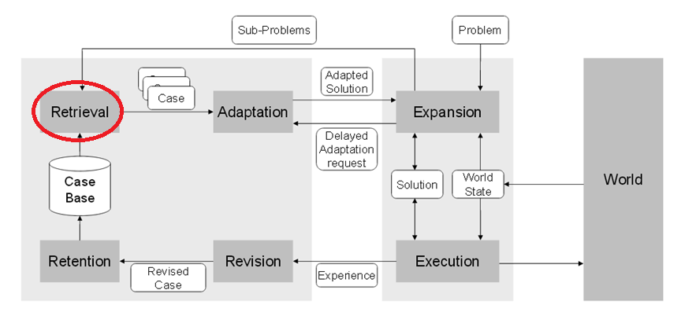
Solution Approach
Improve the retrieval performance [2]

Slide 6
Related Work Summary (1)
Darmok [2]
Observance, adaptive, not intelligent, not real-time
I-Strategizer [3]
Observance, Adaptive, intelligent, not real-time

Slide 7
Related Work Summary (2)
EISBot [4]
Not observance, adaptive, intelligent, not real-time
FSM [5]
Not observance, static, real-time
Drivatar [6]

Slide 8
Evaluation Plan
Frame Rate
Standard is 30 – 60 FPS [7]
Adaptivity Rate
Successful adaptive instance is changing a failed plan to a successful plan
Win Rate:
Static AI, other deliberative agents

Slide 9
References
[1] M. Buro, "Call for AI Research in RTS Games," in American Association for Artificial Intelligence, Palo Alto, California, 2004.
[2] S. Ontanon, K. Mishra, N. Sugandh and a. A. Ram, "On-line case-based," Computational Intelligence, vol. 26, no. 1, pp. 84-119, 2010.
[3] M. Aref, O. Enayet and A. Al-Ogail, "Intelligent online case-based planning agent model for real-time strategy games," in Intelligent Systems Design and Applications, Egypt, Cairo, 2010.
[4] M. M. a. A. J. B. G. Weber, "Building human-level ai for real-time strategy games," in AIIDE Fall Symposium on Advances in Cognitive Systems, Stanford, Palo Alto, California, 2011.
[5] R. Houlette and D. Fu, "The ultimate guide to fsms in games," in AI Game Programming Wisdom 2, 2003.
[6] Microsoft Research, " Drivatar™ in Forza Motorsport," Microsoft Corporation,. [Online]. Available: http://research.microsoft.com/en-us/projects/drivatar/forza.aspx. [Accessed 7 12 2013].
[7] Wikipedia, "Frame rate," Wikimedia Foundation, 24 11 2013. [Online]. Available: http://en.wikipedia.org/wiki/Frame_rate#Video_games. [Accessed 28 11 2013].

Slide 10
Thank you !

